Slide 1
HUEx - Backend Track

Slide 2
Java: A Brief history
Conceived by James Gosling, Patrick Naughton, Chris Wrath, Ed Frank, Mike Sheriden at Sun Microsystems in 1991
Took 18 months to develop the first working version
Initially it was called “OAK”
Renamed to Java in 1995
Runs on over 3 billion systems

Slide 3
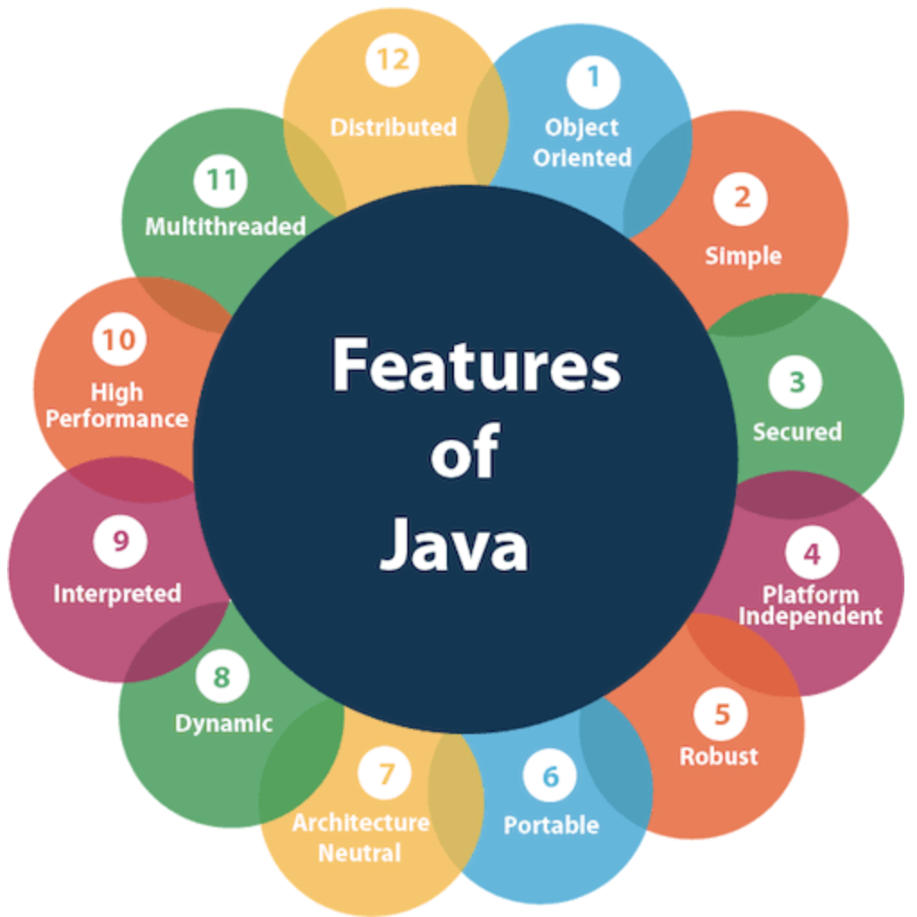
Features of Java

Slide 4
Execution of a Java program:
Abc.java
(a java file)
Abc.class
(Bytecode)
Javac - Java compiler
JVM
Native Machine Code ( 0s and 1s)

Slide 5
Common Terms : Program Execution
Bytecode: is a highly optimized set of instructions which is machine independent. It gets processed by JVM
JVM: is the runtime engine of the Java Platform, which allows any program written in Java to be compiled into Java bytecode to run on any computer that has a native JVM. Hence making Java Platform independent

Slide 6
OOPs - Object Oriented Programming
Object-Oriented Programming is a methodology or paradigm to design a program using classes and objects.
Encapsulation - Wrapping up of data and code into a single unit in-order to prevent them from being accessed arbitrarily by other code. Example: Shifting gears in a car does not affect other functionalities
Inheritance: process by which one object acquires the properties of another object
Polymorphism: from Greek, meaning many forms. Example: Overloading (static polymorphism) or Overriding (Runtime polymorphism)
Abstraction: Hiding of irrelevant information and projection of relevant data. Example: Accelerator of a car

Slide 7
What is a Object?
Mimics any real world entity that has state and behaviour
Example: A dog is an object because it has states like color, name, breed, etc. as well as behaviors like wagging the tail, barking, eating, etc.
Contains an address and takes up space in memory
Can be defined as an instance of class
Created using new keyword

Slide 8
What is a Class?
Is a blueprint from which an individual object can be created
Is a logical entity
Does not hold any space in memory
A class can be shared by multiple objects of same class type

Slide 9
Few more Java concepts:
Constructors:
is a special method which is invoked every time a class is instantiated. That is an object of the class is created
It is called only once - during object creation
If a constructor is not explicitly created then a default constructor is called for object creation by JVM
Can be parameterized
Method Overloading:
Methods with same name but different parameters - different number of arguments, different types of argument
Increases readability of the program
Method Overriding:
If subclass (child class) has the same method as declared in the parent class
Useful in runtime polymorphism, where the subclass have specific implementation for the method defined in parent class

Slide 10
Few more Java concepts:
super:
keyword in Java is a reference variable which is used to refer immediate parent class object.
Whenever you create the instance of subclass, an instance of parent class is created implicitly which is referred by super reference variable
super() can be used to invoke immediate parent class constructor.
this:
used to refer current class instance variable, used to invoke current class method (implicitly)
this() can be used to invoke current class constructor

Slide 11
Few more Java concepts:
static:
Can be applied to variables, method, nested classes and blocks
static method belongs to a class rather than object of a class - no need to instantiate the class
static block is executed before before the main method is invoked at the time of class loading
static variable can be used to refer to the common property of all objects
But, static is evil
final:
Can be applied to variable, class, method
Value for a final variable cannot be changed. It is treated as a constant
final method cannot be overridden
final class cannot be extended

Slide 12
Java Abstraction : Abstract class
Abstract class:
An abstract class must be declared with an abstract keyword.
It can have abstract and non-abstract methods.
It cannot be instantiated.
It can have constructors and static methods also.
It can have final methods which will force the subclass not to change the body of the method.

Slide 13
Java Abstraction : Abstract class
abstract class Shape{
abstract void draw();
}
//In real scenario, implementation is provided by others i.e. unknown by end user
class Rectangle extends Shape{
void draw(){System.out.println("drawing rectangle");}
}
class Circle1 extends Shape{
void draw(){System.out.println("drawing circle");}
}
//In real scenario, method is called by programmer or user
class TestAbstraction1{
public static void main(String args[]){
Shape s=new Circle1();//In a real scenario, object is provided through method, e.g., getShape() method
s.draw();
}
}

Slide 14
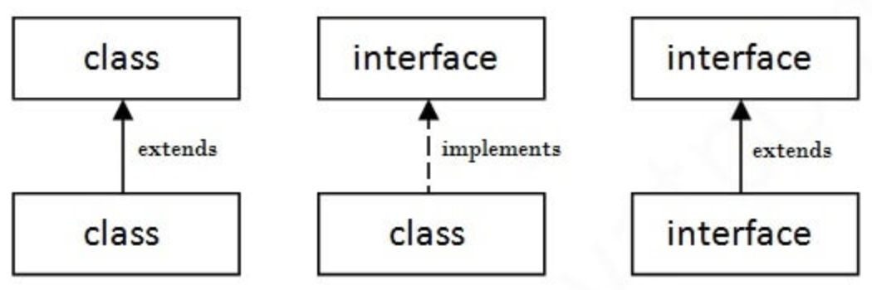
Java Abstraction : Interfaces
It has static constants and abstract methods. No method body
It cannot be instantiated
Since Java 8, we can have default and static methods in an interface.
Class uses implements keyword
Relationship between classes and interfaces

Slide 15
Diamond problem
Java does not support multiple inheritance. It supports multilevel inheritance
A
A
B
B
C
C
D
D

Slide 16
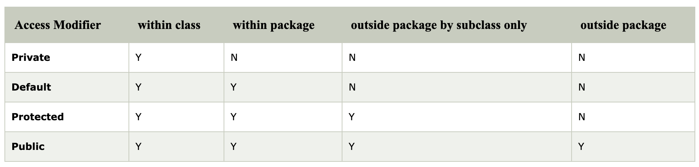
Access Modifiers:
specifies the accessibility or scope of a field, method, constructor, or class.
We can change the access level of fields, constructors, methods, and class by applying the access modifier on it.

Slide 17
Java Collections
is a framework that provides an architecture to store and manipulate the group of objects.
Operations such as searching, sorting, insertion, manipulation, and deletion can be performed
Provides many interfaces like
Set
Map
List
Queue
Deque
...
Provides many classes like
ArrayList
Vector
LinkedList
PriorityQueue
HashSet
HashMap
...

Slide 18
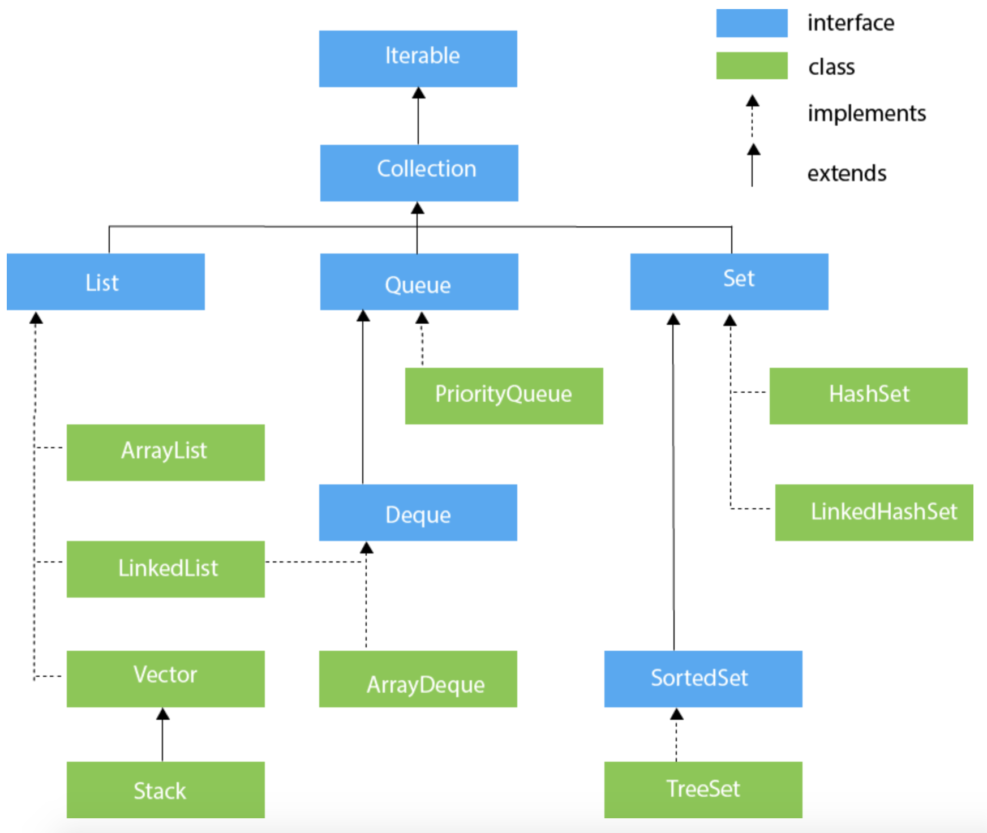
Hierarchy of Collection Framework

Slide 19
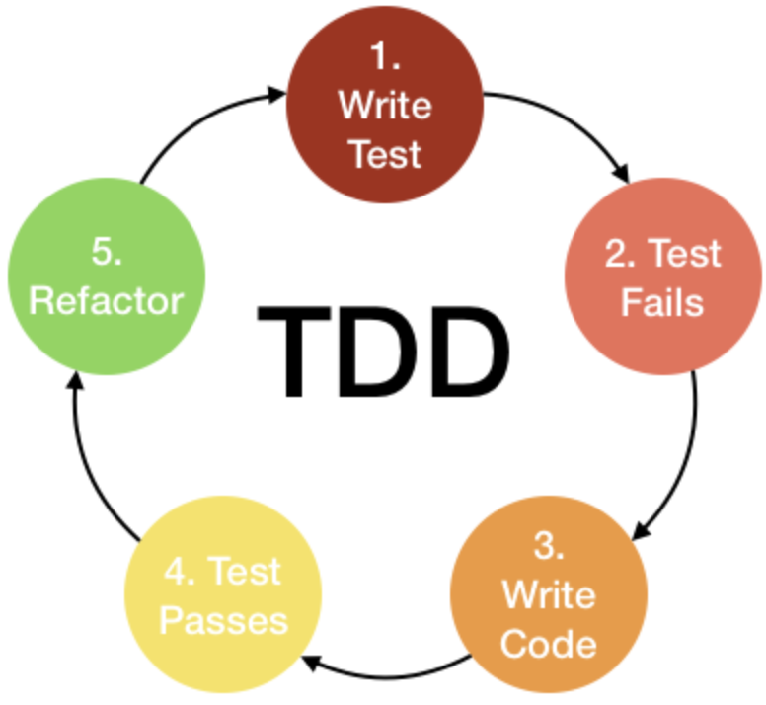
TDD: Test Driven Development
Test before development

